Slide 1

GITHUB · TESTING · HOSTING
From Push to Production
How a change is versioned, tested, shipped and checked before it reaches a real user
GitHub Actions · xUnit · Jest · Azure · Vercel · Neon
BY: FUNI MAPUNDA (ST10438308)

Slide 2




GITHUB
Version control, as it actually happened
01
02
03
04
One branch per feature
Named for the owner and the feature, like Lofentse-Staff_Training_Page.
Pull requests into main
Work reaches main through pull requests, so every merge is a visible step.
Reverts, not panic
When a merge broke a build, revert pull requests (#88, #97) rolled it back cleanly.
Staying current
Branches merge main back in, so a long-running branch never drifts from what is deployed.

Slide 3


CI/CD
From git push to Azure, automatically
Push or PR
to main
Build
.NET 8, Release
Test
dotnet test
Publish
dotnet publish
Deploy
Azure App Service
Deploy only runs for pushes to main, never for pull requests.
GitHub Actions
The publish profile is a GitHub secret, never in the repo.
29
1
0
tests passed
xUnit
skipped
a known bug
failed
on main
uses: azure/webapps-deploy@v3
Notes:
- GitHub Actions: build, test, publish, deploy
- 29 passed, 1 skipped
- Deploys only from main

Slide 4


CI/CD
The details that make it safe
1
2
3
Two jobs, one gate
Deploy needs the build-and-test job, so a failing test means nothing ships.
A secret, not source
Azure's publish profile lives in a GitHub secret, never in the repo.
The front end too
Frontend CI runs the web app's tests, and Vercel deploys on every push to main.
1
needs: build-and-test
2
${{ secrets.AZURE_WEBAPP_PUBLISH_PROFILE }}
3
npm test
A gotcha we hit: Downloading the publish profile needed SCM Basic Auth Publishing Credentials switched on in Azure. It is off by default.

Slide 5


TESTING
Four layers of testing
01
02
03
04
Unit tests
xUnit on the backend, Jest on both front ends. Small, fast, run on every push.
Component tests
React Native Testing Library, testing screens the way a person uses them.
API and data checks
Every endpoint tried in Swagger with real tokens, then the database queried.
Real devices
TestFlight and Android builds run on real phones against the live API.

Slide 6
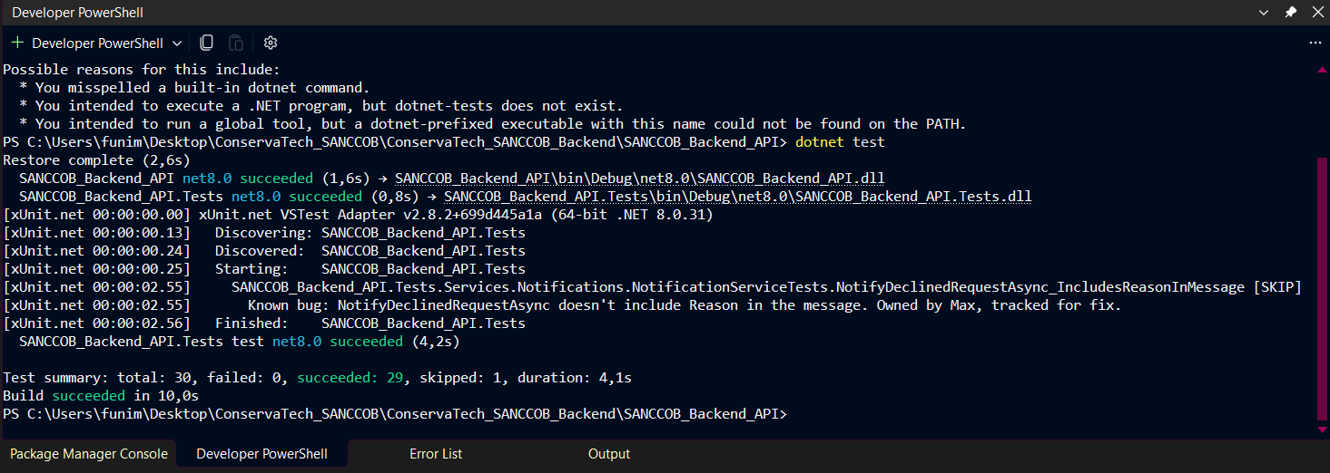
TESTING
What the backend tests cover
dotnet test SANCCOB_Backend_API.Tests
TimeSlotParser
Turns a shift's time slot into hours, the number every weekly-hours rule uses.
1
SCREENSHOT
dotnet test: passed, skipped, failed
Replace this box with a screenshot of the test run
2
OtpGenerator
One-time codes are well formed and get an expiry.
3
NotificationService
Who gets notified, and what the message says.
A test that found a real bug. The declined-request message left out the reason. The test is skipped, with the reason written on it, so the bug is documented, not hidden.

Slide 7
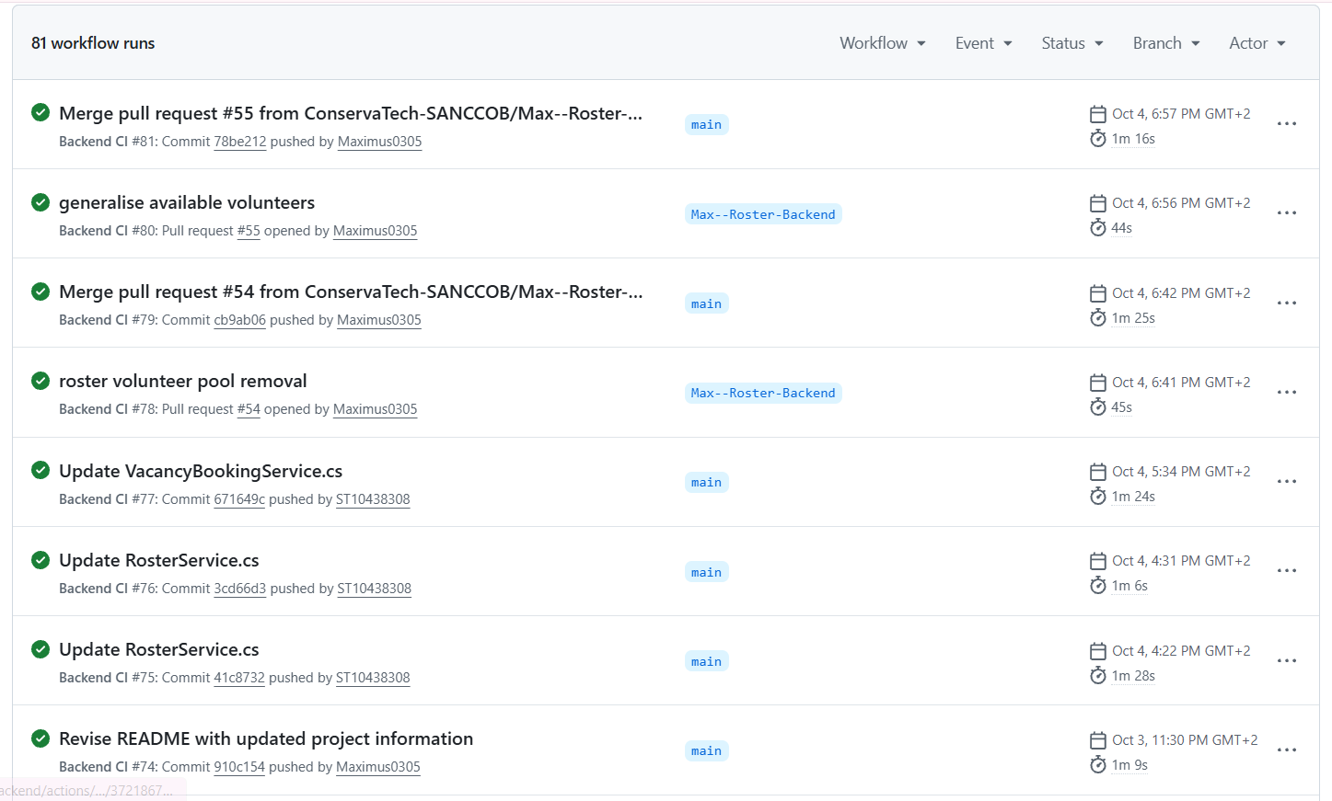
TESTING
Coverage across every layer
Backend, mobile and web, all passing.
Nothing ships untested
A failing test in any layer fails CI before Azure, Vercel or TestFlight.
29
120
50
backend tests
xUnit, 1 skipped by design
mobile app tests
Jest and React Native Testing Library
web dashboard tests
Jest, 14 suites
dotnet test · npm test

Slide 8

TESTING
Proving it works, not just that it compiles
STEP 1
STEP 2
STEP 3
STEP 4
Work out the answer first
For one volunteer the rules say 8 of 12 shifts, with Friday and Sunday skipped.
Test the broadcast alone
A listener page proved the SignalR broadcast before any dashboard screen existed.
Decode the token
Confirm the claims inside, like the verified trainerId on a trainer token.
Check the data
A success message doesn't prove the right data was saved, so query it.
What the database held for that volunteer after roster generation:
SELECT * FROM roster_assignment WHERE user_id = 9

Slide 9



TESTING
Security checks, run like an attacker
01
02
03
04
Wrong role
Call an admin endpoint with a volunteer token. It must answer 403. The first time it answered 201, and that was fixed.
Logged-out token
Log out, then reuse the old token. It must be refused.
PIN guessing
Hit the trainer PIN endpoint repeatedly. After 10 tries in a minute it must answer 429.
Someone else's data
Ask for another volunteer's hours or training profile. It must be blocked.

Slide 10

WHAT TESTING CAUGHT
Rostering and bookings
01
02
03
04
Full Day ignored
Found: Free all day, but not matched to a morning shift.
Cause: Availability was compared as an exact string.
Fix: A coverage map: Full Day covers both halves.
Duplicate rosters
Found: Seven rosters for the same week.
Cause: Generate never checked for an existing one.
Fix: It returns the existing roster.
Booking, no roster
Found: Booking an open shift said it had no roster.
Cause: The roster was copied from another assignment.
Fix: Look the roster up by week.
Missed alerts
Found: A volunteer free all day never got the vacancy alert.
Cause: The same exact-string match, in the notifications.
Fix: The same coverage map.

Slide 11

WHAT TESTING CAUGHT
Safety and correctness
01
02
03
04
Removal crashed
Found: Removing an assignment returned a 500.
Cause: It hard-deleted a row a change request pointed at.
Fix: Mark it Vacant, and reuse that row on re-assign.
Open admin routes
Found: A volunteer token generated a roster (201).
Cause: Only class-level authorization.
Fix: Admin-only on every write.
Double-booked
Found: Two overlapping shifts on the same day.
Cause: Booking skipped the overlap check.
Fix: Added the check roster generation uses.
Transaction failed
Found: Booking failed with an execution-strategy error.
Cause: Retry-on-failure needs transactions inside a strategy.
Fix: Wrapped it in CreateExecutionStrategy().

Slide 12
HOSTING
Where it runs, and how it is configured
ConnectionStrings:DefaultConnection
Neon database
API: Azure App Service
Spain Central, deployed only from GitHub Actions.
1
Jwt:Key
Signs every token
2
Database: Neon PostgreSQL
Serverless, with retry-on-failure for autosuspend resets.
Acs:ConnectionString
Sends the emails
3
TrainerAccess:Pin
The trainer PIN
4
Dashboard: Vercel
Deploys automatically on every push to main.
NEXT_PUBLIC_API_URL
Web app finds the API
5
Mobile: Expo EAS
TestFlight and Android builds; JS fixes go over the air.
EXPO_PUBLIC_API_URL
Mobile app finds the API
6
Local: user secrets. Azure: the same key, with : written as __

Slide 13




WHAT I'D BUILD NEXT
Honest next steps
Automate the checks
Turn the manual API checks into integration tests against a test database
Add a staging step
So Azure is not the first real test of a merge
Roll back on failure
Automatic rollback if a deploy passes CI but fails a health check
Thank you

